Slide 1
Handling Events in React
React Main Concept #6

Slide 2
Syntactic Differences of Handling Events with React Elements vs DOM Elements
DOM
React
Events are lowercase
Event handlers are passed as strings.
Events are camelCase
Event handlers are passed as functions.

Slide 3


Syntactic Differences of Handling Events with React Elements vs DOM Elements
DOM
React
Events are lowercase
Event handlers are passed as strings.
Example:
Events are camelCase
Event handlers are passed as functions.
Example:

Slide 4
Prevent Default
All native HTML elements come with their internal native behaviour.
In React, you can’t return false to prevent a default behaviour. If there is a default behaviour that you are trying to prevent, you must call preventDefault() explicitly.

Slide 5
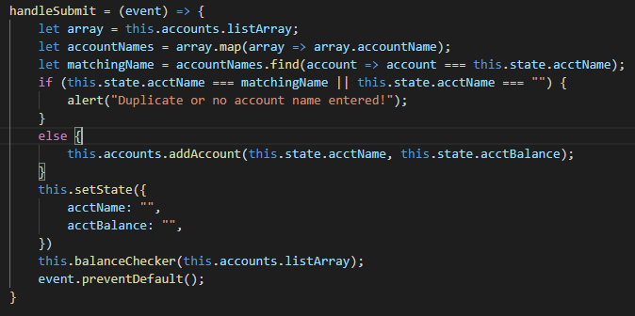
Prevent Default
In the following example from when I migrated my accounts exercise, preventDefault() was used to prevent the default behaviour of a form submit button, which would normally refresh the browser when it is clicked.

Slide 6
Extra Prevent Default Info
Another fairly common use for preventDefault() is to prevent the default behaviour when clicking on a link (going to the link’s URL)
In some situations, browsers will wait to see if preventDefault() is going to be called before proceeding with an event. One specific instance where this can cause issues is with the touchmove event that has to do with scrolling via a touch screen (primarily for mobile apps). Browsers can pause momentarily to check for preventDefault() before continuing to scroll. This can cause the scrolling to delay and “jitter”. In order to prevent the browser from waiting to check for preventDefault, you can specify “passive: true” in your event listener.

Slide 7
Why We Need to Bind “This”
In JavaScript, class methods are not bound by default. If ‘this’ is not bound, and you pass a method (example: this.handleClick) to an event (example: <button onClick={this.handleClick}), ‘this’ will be undefined when the method is called.
As a general rule, if you refer to a class method without () after it, you should bind that method.

Slide 8
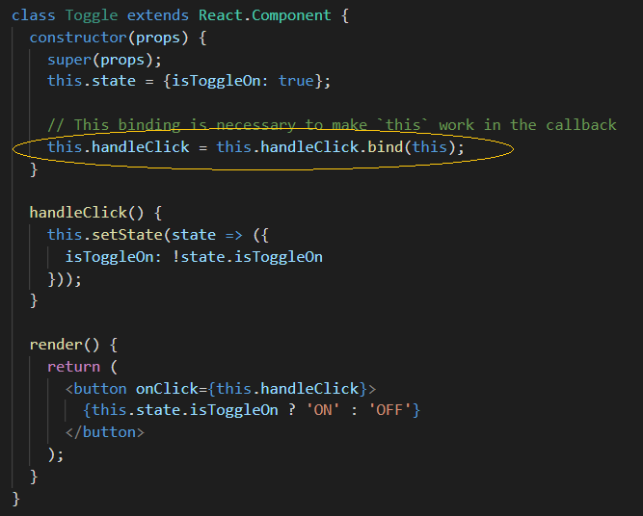
First Way to Bind “This”
One way of binding “this” is to call the “bind” method. Example:
Downsides of this binding tactic:
It’s easy to forget to call the bind method in the constructor, resulting in undefined errors.
It can clutter the constructor if you have a lot of methods that require binding.

Slide 9
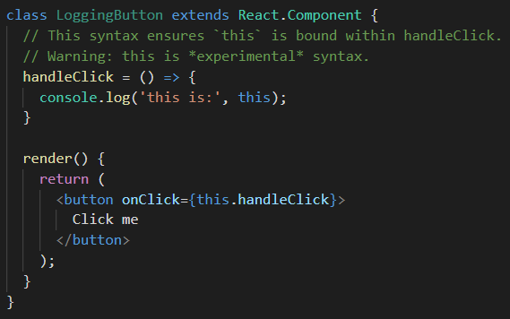
Second Way to Bind “This”
Another way of binding “this” is to use the public class fields syntax.
Downsides of this binding tactic:
According to this article from this year :https://dev.to/ascorbic/class-fields-are-coming-heres-what-that-means-for-react--3a87, there are “potential performance issues if you are creating loads of copies of a component. While a class method is created once on the prototype, class fields are created on each object: each component will have its own copy of each function. However this is only likely to be an issue if you are creating hundreds of instances.”

Slide 10
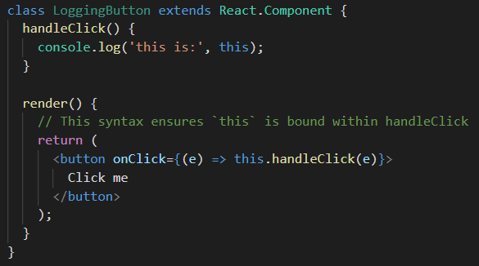
Third Way to Bind “This”
The third way is to use an arrow function within the callback itself.
Downsides of this binding syntax:
A different callback is created every time the class renders. If this callback is passed as a prop to lower components, those components might do an extra re-rendering. This creates a potential performance problem.

Slide 11
Passing Arguments to Event Handlers
If you need to pass an extra parameter to an event handler, you can use either of the following techniques:
Arrow Function:
In this example, the e argument representing the React event will be passed as a second argument to the event handler after the id.
With the arrow function syntax, you need to pass the event explicitly.
Bind Method:
Since we use bind in this example, we no longer have to pass the event explicitly. The event and any further arguments are automatically forwarded to the event handler.

Slide 12
END

